Slide 1
Data Encryption Standard (DES)
Adopted from “Cryptography and Network Security” by W. Stallings

Slide 2
Content
Block and Stream cipher
Scheme for cipher design
S-P network
Feistel networks
Others
DES structure

Slide 3
Recap: Block vs Stream Ciphers
Stream ciphers process messages a bit or byte at a time when en/decrypting (i.e. video stream)
Block ciphers process messages in blocks, typical block size is 64 or 128 bits, each of which is then en/decrypted
Most current ciphers are block ciphers
Broader range of applications (nature of data)
Allow more complex design (possibly more secure if implemented properly)
Notes:
Stream cipher mostly XOR the key stream with data stream, bit or byte → Simpler and faster. If properly designed it is secured. If key stream is as long as the plain text and every key stream is random.
Key1 XOR data1 → cipher text1 then move on to Key2 XOR data2 → cipher text2
However block cipher has more complex interaction between plaintext and cipher key generated.
Hence more complex, slow → Could be more secure
Block cipher could also be chained → change be used to process variable length data block (which is how data is) → broader range of applications,
Block cipher being more used is also more studied / researched.

Slide 4
Block Cipher Principles
Most symmetric block ciphers are based on the following :
Substitution-Permutation networks
Feistel Scheme
Generalized Feistel Scheme (A variants of Feistel Scheme - not tested)
Lai-Massey Scheme (not tested)
Block ciphers → large substitution tool
The choice of block size does not directly affect to the strength of encryption scheme. The strength of cipher depends up on the key length.
Implemented from smaller building blocks
Typically is a product cipher
Notes:
Most symmetric block encryption algorithms in current use are based on a structure referred to as a Feistel cipher structure. There are others such as the SP Nets used in AES
We only discuss the first 2 in some details
Generalized Feistel scheme are variants based on original feistel scheme . The Lai-massey scheme have many similaritities though by itself it is a worthy to be called a scheme by itself.
A block cipher operates on a plaintext block of n bits to produce a ciphertext block of n bits. An arbitrary reversible substitution cipher for a large block size is not practical, however, from an implementation and performance point of view. In general, for an n-bit general substitution block cipher, the size of the key to thwart statistical attacks is n x 2^{n}. For a 64-bit block, which is a desirable length to thwart statistical attacks, the key size is 64 x 2⁶⁴ = 2⁷⁰ = 10²¹ bits. In considering these difficulties, Feistel points out that what is needed is an approximation to the ideal block cipher system for large n, built up out of components that are easily realizable.

Slide 5
Substitution-Permutation Networks
Proposed by Claude Shannon in 1949
Basis of modern Block ciphers
introduced idea of substitution-permutation networks (S-P nets)
Based on 2 primitive cryptographic operations:
substitution (S-box of the cipher)
permutation (P-box of the cipher)
Provide confusion & diffusion of message & key.
The AES standard uses iterated substitution-permutation networks for encryption / decryption.
Notes:
Claude Shannon’s 1949 paper has the key ideas that led to the development of modern block ciphers. Critically, it was the technique of layering groups of S-boxes separated by a larger P-box to form the S-P network, a complex form of a product cipher. He also introduced the ideas of confusion and diffusion, notionally provided by S-boxes and P-boxes (in conjunction with S-boxes).

Slide 6
Substitution-Permutation Networks
Cipher should completely obscure statistical properties of original message
Practically Shannon suggested combining Subsititution & Permutation elements to obtain:
Diffusion – Seeks to make the statistical relationship between the plaintext and ciphertext as complex as possible in order to prevent attempts to deduce the key. (uses permutation or transposition)
Confusion – makes relationship between ciphertext and key as complex as possible so as to prevent attempts to discover key (uses substitution)
Notes:
The terms diffusion and confusion were introduced by Claude Shannon to capture the two basic building blocks for any cryptographic system. Every block cipher involves a transformation of a block of plaintext into a block of ciphertext, where the transformation depends on the key. The mechanism of diffusion seeks to make the statistical relationship between the plaintext and ciphertext as complex as possible in order to thwart attempts to deduce the key. Confusion seeks to make the relationship between the statistics of the ciphertext and the value of the encryption key as complex as possible, again to thwart attempts to discover the key.
So successful are diffusion and confusion in capturing the essence of the desired attributes of a block cipher that they have become the cornerstone of modern block cipher design.
Confusion → Includes key expansion

Slide 7
Feistel Scheme - Background
Widely used to illustrate block cipher design principles
Variants based on “classical” feistel scheme
Unbalanced Feistel networks
With expanding and contracting rounds
Alternating Feistel networks
With steps alternate in expanding and contracting rounds
Others
Used in DES
Once most widely cryptographic algorithms
Proven secrecy
Notes:
Modern block ciphers are widely used to provide encryption of quantities of information, and/or a cryptographic checksum to ensure the contents have not been altered. We continue to use block ciphers because they are comparatively fast, and because we know a fair amount about how to design them. Will use the widely known DES algorithm to illustrate some key block cipher design principles.

Slide 8
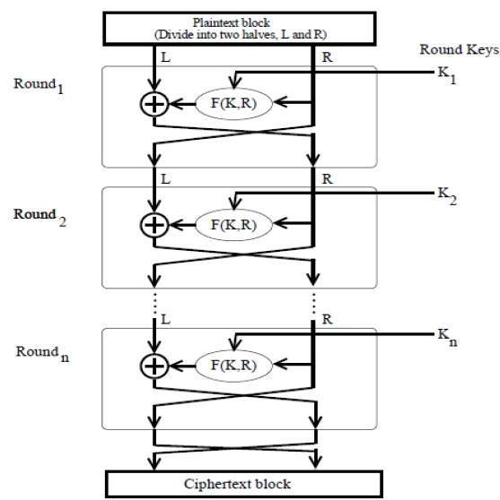
Feistel Scheme - Construction
Construction of Feistel cipher
Split input block (data) into two halves
Using data from right half
Apply substitution + subkey
XOR with the left half
Swapping halves in the next cycle
Notes:
Pronounce : Horse (T) – Fives–Tel (for Horst Feistel)
Horst Feistel, working at IBM Thomas J Watson Research Labs devised a suitable invertible cipher structure in early 70's.
One of Feistel's main contributions was the invention of a suitable structure which adapted Shannon's S-P network in an easily inverted structure. It partitions input block into two halves which are processed through multiple rounds which perform a substitution on left data half, based on round function of right half & subkey, and then have permutation swapping halves. Essentially the same h/w or s/w is used for both encryption and decryption, with just a slight change in how the keys are used. One layer of S-boxes and the following P-box are used to form the round function.

Slide 9
Feistel Scheme – Construction (cont)
Note: R₀ = L₁
(data unchanged)
[F] - Round Function perform the S-box and P-box
After 2 rounds = All data (Left & Right halves) will be encrypted once
Notes:
Stallings Figure 3.2 illustrates the classical feistel cipher structure, with data split in 2 halves, processed through a number of rounds which perform a substitution on left half using output of round function on right half & key, and a permutation which swaps halves, as listed previously.

Slide 10
Feistel Cipher - Design Elements
Considerations
block size
key size
number of rounds
Subkey(K₁, K₂, K₃… K_{n}) generation algorithm
round function
Note : Greater complexity can make analysis harder but slows cipher – Trade off!
Notes:
The exact realization of a Feistel network depends on the choice of the following parameters and design features:
block size - increasing size improves security, but slows cipher
key size - increasing size improves security, makes exhaustive key searching harder, but may slow cipher
number of rounds - increasing number improves security, but slows cipher
subkey generation algorithm - greater complexity can make analysis harder, but slows cipher
round function - greater complexity can make analysis harder, but slows cipher
fast software en/decryption - more recent concern for practical use
ease of analysis - for easier validation & testing of strength

Slide 11
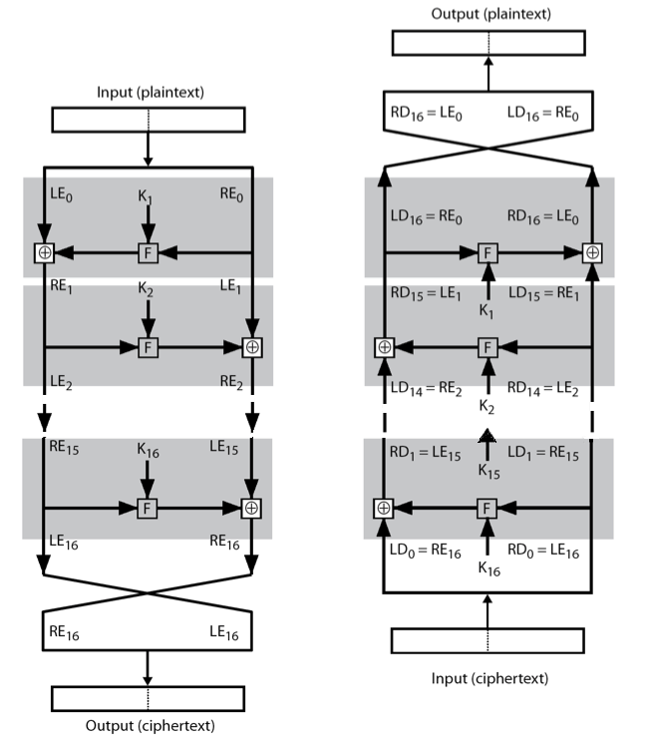
Feistel Cipher - Decryption
Decryption process is essentially the same as the encryption
Encryption
16 subkeys generated from the key
Decryption
Reverse the subkeys applied. i.e. K_{n} in first round, K_{n-1} second and K₁ last.
Implementation
Only 1 set of instructions needed
Recall R₀ = L₁
Using [F] + subkey + L₁, to generate same output as encryption
XOR with R₁ to get R₀
Notes:
The process of decryption with a Feistel cipher, as shown in Stallings Figure 3.3, is essentially the same as the encryption process. The rule is as follows: Use the ciphertext as input to the algorithm, but use the subkeys Ki in reverse order. That is, use Kn in the first round, Kn–1 in the second round, and so on until K1 is used in the last round. This is a nice feature because it means we need not implement two different algorithms, one for encryption and one for decryption.

Slide 12
Data Encryption Standard (DES)
Widely used block cipher specified and adopted by US government
Adopted by National Bureau of Standards (NBS) (now NIST) in 1977 as Federal Information Processing Standard (FIPS) PUB 46
Encrypts 64-bit data using 56-bit key
Notes:
The most widely used private key block cipher, is the Data Encryption Standard (DES). It was adopted in 1977 by the National Bureau of Standards as Federal Information Processing Standard 46 (FIPS PUB 46). DES encrypts data in 64-bit blocks using a 56-bit key. The DES enjoys widespread use. It has also been the subject of much controversy its security.
Accepts 64 bit key but 8 parity bits are dropped

Slide 13
DES - History
IBM developed Lucifer cipher
Team led by Feistel in late 60’s
used 64-bit data blocks with 128-bit key
Redeveloped as a commercial cipher with input from National Security Agency(NSA) and others
National Bureau of Standards (NBS) issued request for proposals for a national cipher standard (in 1973 )
IBM submitted their revised Lucifer cipher, later accepted as the DES
Notes:
In the late 1960s, IBM set up a research project in computer cryptography led by Horst Feistel. The project concluded in 1971 with the development of the LUCIFER algorithm. LUCIFER is a Feistel block cipher that operates on blocks of 64 bits, using a key size of 128 bits.
Because of the promising results produced by the LUCIFER project, IBM embarked on an effort, headed by Walter Tuchman and Carl Meyer, to develop a marketable commercial encryption product that ideally could be implemented on a single chip. It involved not only IBM researchers but also outside consultants and technical advice from NSA. The outcome of this effort was a refined version of LUCIFER that was more resistant to cryptanalysis but that had a reduced key size of 56 bits, to fit on a single chip.
In 1973, the National Bureau of Standards (NBS) issued a request for proposals for a national cipher standard. IBM submitted the modified LUCIFER. It was by far the best algorithm proposed and was adopted in 1977 as the Data Encryption Standard.

Slide 14
DES - Design Controversy
DES standard is public but considerable controversy over its design
Choice of 56-bit key (vs Lucifer 128-bit) although DES is designed to accept 64-bit key
S-boxes used were designed under classified conditions and led people to think that is a “trapdoor” for NSA
Broken (currently): due to its 56-bit key
DES is heavily used in legacy applications especially in financial applications.
Notes:
Before its adoption as a standard, the proposed DES was subjected to intense & continuing criticism over the size of its key & the classified design criteria.
Recent analysis has shown despite this controversy, that DES is well designed. DES is theoretically broken using Differential or Linear Cryptanalysis but in practise is unlikely to be a problem yet. Also rapid advances in computing speed though have rendered the 56 bit key susceptible to exhaustive key search, as predicted by Diffie & Hellman.
DES has flourished and is widely used, especially in financial applications. It is still standardized for legacy systems, with either AES or triple DES for new applications.

Slide 15
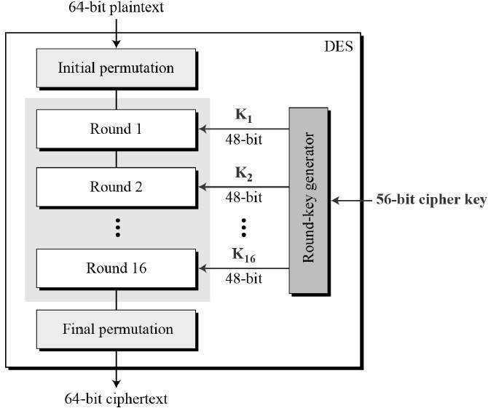
DES Encryption - Overview
Encryption Steps
Initial permutation (IP)
16 key dependent round functions
Final permutation
Notes:
The overall scheme for DES encryption is illustrated in Stallings Figure3.4, which takes as input 64-bits of data and of key.
The left side shows the basic process for enciphering a 64-bit data block which consists of:
- an initial permutation (IP) which shuffles the 64-bit input block
- 16 rounds of a complex key dependent round function involving substitutions & permutations
- a final permutation, being the inverse of IP
The right side shows the handling of the 56-bit key and consists of:
- an initial permutation of the key (PC1) which selects 56-bits out of the 64-bits input, in two 28-bit halves
- 16 stages to generate the 48-bit subkeys using a left circular shift and a permutation of the two 28-bit halves

Slide 16
1st and Last Step : Initial & Inverse Initial Permutation
The initial and final permutations are straight Permutation boxes (P-boxes) that are inverses of each other.
Initial Permutation (1st Step)
Inverse Initial Permutation (Last Step)
Notes:
Show how data are being moved. It could implemented using software or hardware

Slide 17
DES - Round Structure
[F] Round function (illustrated with R half)
expands R from 32 → 48-bit using Expansion P-box function
XOR with 48-bits subkey K
passes through 8 S-boxes to get 32-bit result
Permutes using 32-bit [P] function
Notes:
Detail here the internal structure of the DES round function F, which takes R half & subkey, and processes them through E, add subkey, S & P.
This follows the classic structure for a feistel cipher.
Note that the s-boxes provide the “confusion” of data and key values, whilst the permutation P then spreads this as widely as possible, so each S-box output affects as many S-box inputs in the next round as possible, giving “diffusion”.

Slide 18
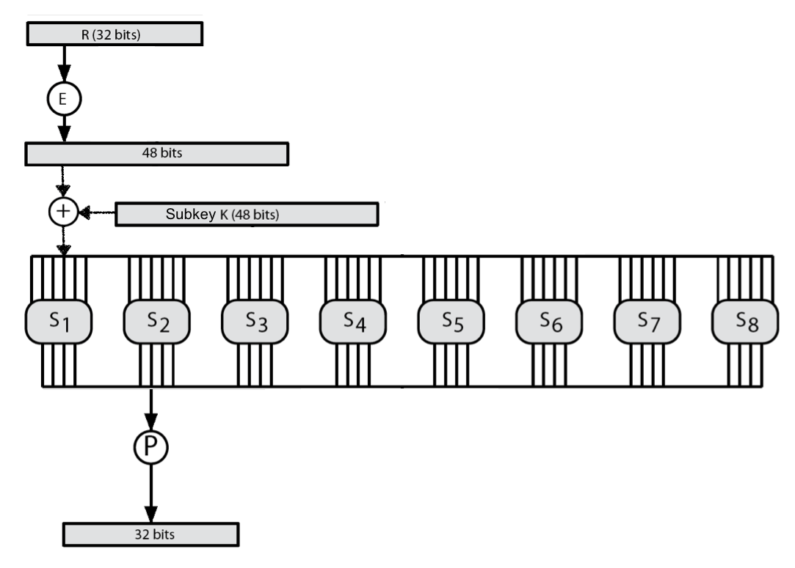
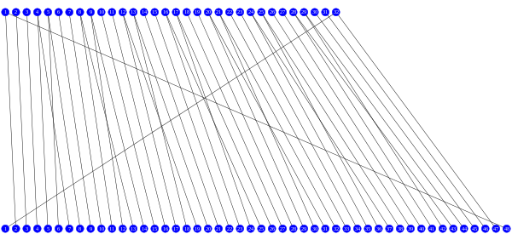
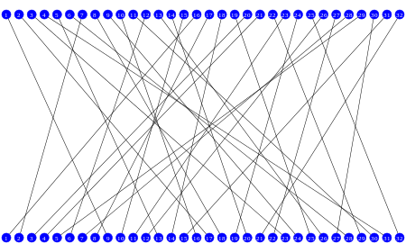
DES - Round Function [F] – Another illustartion
Internal mapping of E function
Internal mapping of P function
Image source of P & E function: DES Supplementary Material." Wikipedia,
DES round function modified from Stallings Fig 3.6
Notes:
Stallings Figure 3.6 illustrates the internal structure of the DES round function F. The R input is first expanded to 48 bits by using expansion table E that defines a permutation plus an expansion that involves duplication of 16 of the R bits (Stallings Table 3.2c). The resulting 48 bits are XORed with Ki. This 48-bit result passes through a substitution function comprising 8 S-boxes which each map 6 input bits to 4 output bits, producing a 32-bit output, which is then permuted by permutation P as defined by Stallings Table 3.2d.
E= expansion function from 32 bits to 48 bits

Slide 19
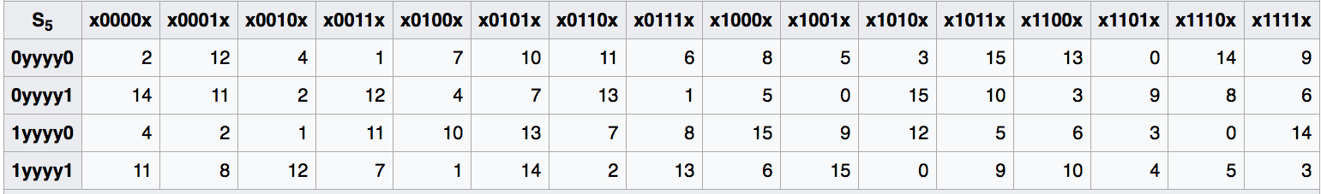
Substitution Boxes S
The 8 different S-boxes working in parallel
Map 6 to 4 bits (hence 48 → 32 bits)
The value in the selected cell (in the S-Box) is returned after the process
Bits 1 & 6 (row bits or outer bits)
Bits 2-5 (col bits or inner bits)
Example : S5(011011) → 9 (or 1001), where 0yyyy1 determines the row and
x1101x determines the column
Notes:
Special Attention Required
The substitution consists of a set of eight S-boxes, each of which accepts 6 bits as input and produces 4 bits as output. These transformations are defined in Stallings Table 3.3, which is interpreted as follows: The first and last bits of the input to box Si form a 2-bit binary number to select one of four substitutions defined by the four rows in the table for Si. The middle four bits select one of the sixteen columns. The decimal value in the cell selected by the row and column is then converted to its 4-bit representation to produce the output. For example, in S1, for input 011001, the row is 01 (row 1) and the column is 1100 (column 12). The value in row 1, column 12 is 9, so the output is 1001.
The example lists 8 6-bit values (ie 18 in hex is 011000 in binary, 09 hex is 001001 binary, 12 hex is 010010 binary, 3d hex is 111101 binary etc), each of which is replaced following the process detailed above using the appropriate S-box.

Slide 20
DES - Decryption
Decrypt must unwind steps of data computation
With Feistel design, do encryption steps again using subkeys in reverse order (SK₁₆ … SK₁)
IP undoes final permutation step of encryption
1st round with SK₁₆ undoes 16th encrypt round
….
16th round with SK₁ undoes 1st encrypt round
then final permutation undoes initial permutation IP
thus recovering original data value!!
Notes:
As with any Feistel cipher, DES decryption uses the same algorithm as encryption except that the subkeys are used in reverse order SK16 .. SK1.
If you trace through the DES overview diagram can see how each decryption step top to bottom with reversed subkeys, undoes the equivalent encryption step moving from bottom to top.

Slide 21
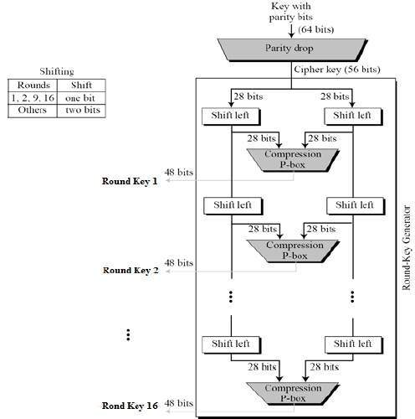
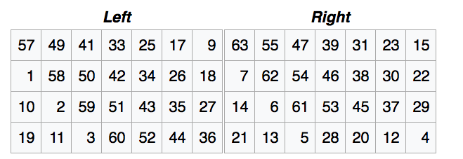
DES - Key Schedule
Generate 16 subkeys (from the secret key)
Use PC-1 for initial permutation
Only 56-bits used (bit 8, 16, 24, 32, 40, 48, 56, 64 are considered as parity bits)
The resulted 56-bits intermediate subkey is split into 2 x 28-bits halves
To do a left shift we move each bit one place to the left, except for the first bit which goes to the end of the block.
PC-1
PC-2
PC-1
Notes:
Note the table will take
- Bit 57 and used it as the first bit of the output for the left halves
- Bit 63 and used it as the first bit of the output for the right halves

Slide 22
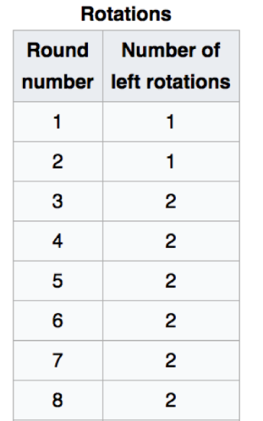
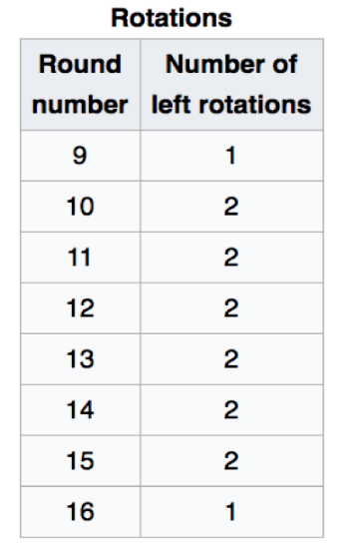
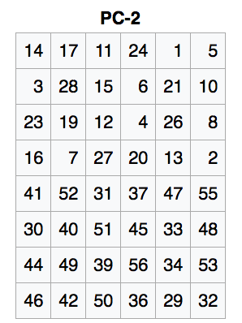
DES - Key Schedule (cont’d)
Refinement of the 16 subkeys
Left rotate each halves separately (1 or 2 places based on key rotation schedule K)
Use PC-2 for permutation & select 48 bits from 56 bits.
Notes:
Use the Key rotation schedule K to “Left rotate” the halves ( ie round 1 , rotate left once, but 2x in round 3)
Use PC2 to select bit 14 output as first bit of the key. Only 6 x 8 = 48 bits are selected from 56 bits
Bits 9, 18, 22, 25, 35, 38, 43, 54 are dropped.

Slide 23
Avalanche Effect
Desirable property of encryption algorithms
DES exhibits strong avalanche
1 bit change of the input or key, ≈ half output bits changed
Notes:
A desirable property of any encryption algorithm is that a small change in either the plaintext or the key should produce a significant change in the ciphertext. In particular, a change in one bit of the plaintext or one bit of the key should produce a change in many bits of the ciphertext. If the change were small, this might provide a way to reduce the size of the plaintext or key space to be searched. DES exhibits a strong avalanche effect, as may be seen in Stallings Table 3.5.

Slide 24
DES - Considerations
56-bit keys have 2⁵⁶ = 7.2 x 10¹⁶ values
Brute force search looks hard (previously)
recent advances have shown it is possible
in 1997 on Internet in a few months
in 1998 on dedicated h/w (EFF) in a few days
in 1999 above combined in 22hrs!
still must be able to recognize plaintext
must now consider alternatives to DES
Notes:
The 56 bit key size comes from security considerations as we know now. It was big enough so that an exhaustive key search was about as hard as the best direct attack (a form of differential cryptanalysis called a T-attack, known by the IBM & NSA researchers), but no bigger. The extra 8 bits were then used as parity (error detecting) bits, which makes sense given the original design use for hardware communications links. However we hit an incompatibility with simple s/w implementations since the top bit in each byte is 0 (since ASCII only uses 7 bits), but the DES key schedule throws away the bottom bit! A good implementation needs to be cleverer!
Since its adoption as a federal standard, there have been lingering concerns about the level of security provided by DES in two areas: key size and the nature of the algorithm.
With a key length of 56 bits, there are 2^56 possible keys, which is approximately 7.2*10^16 keys. Thus a brute-force attack appeared impractical.
However DES was finally and definitively proved insecure in July 1998, when the Electronic Frontier Foundation (EFF) announced that it had broken a DES encryption using a special-purpose "DES cracker" machine that was built for less than $250,000. The attack took less than three days. The EFF has published a detailed description of the machine, enabling others to build their own cracker [EFF98].
There have been other demonstrated breaks of the DES using both large networks of computers & dedicated h/w, including:
- 1997 on a large network of computers in a few months
- 1998 on dedicated h/w (EFF) in a few days
- 1999 above combined in 22hrs!
It is important to note that there is more to a key-search attack than simply running through all possible keys. Unless known plaintext is provided, the analyst must be able to recognize plaintext as plaintext.
Clearly must now consider alternatives to DES, the most important of which are AES and triple DES.

Slide 25
Summary
Block vs stream ciphers
Feistel cipher design & structure
DES
Implementation details
Considerations of DES
Notes:
Chapter 3 summary.

